Slide 1

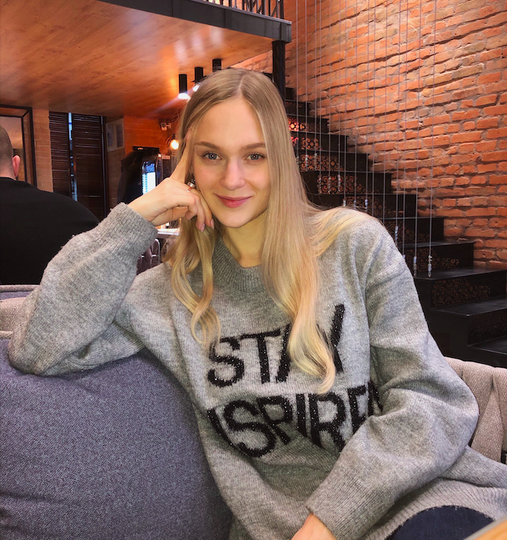
Daria Solodey
Methodist, course creator

Slide 2


Slide 3

Lesson plan
revise 5 interview questions
Notes:
Развернутый комментарий.

Slide 4
Interview questions:
Tell me about yourself
What do you do to improve your English?
How can you improve your professional skills?
What is unacceptable for you at work?
What should you do if you don’t know how to meet a challenge?

Slide 5
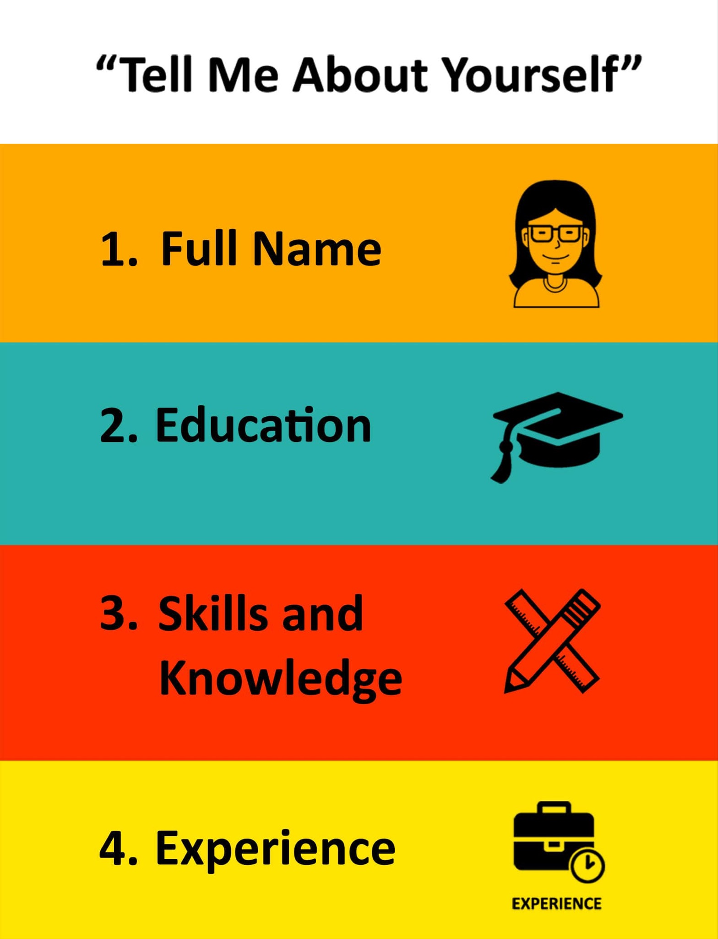
Interview question: Tell me about yourself
Useful language:
- I completed a Bachelor’s/Master’s degree in ____.
- I'm really energetic, and a great communicator.
- I am hard-working / reliable / organised / honest / cooperative / punctual.
- I managed to get a job in...
- I realised…
- I decided...

Slide 6
What do you do to improve your English?
watch movies/series in English
watch YouTube videos
learn 1 new word every day
attend courses
study with a tutor
read technical literature
take a course in programming in English

Slide 7




How can you improve your professional skills?
Specialized course
After work-hours study
English learning

Slide 8

What is unacceptable for you at work?
Why?
Dishonesty
Betrayal
Lie
Gossip
Laziness
Being rude to colleagues
Disrespect
In my opinion,...
I think that… is/are unacceptable at work
To my mind...

Slide 9

What have you learnt this lesson?
I can:
answer 5 interview questions
Notes:
Развернутый комментарий

Slide 10
Thank you!

